Slide 1

Hunter x Hunter or Made in Abyss?
A User-Empowered Anime Recommender System
Binh Hoang

Slide 2





Anime Streaming War
Global anime market valued at $20 bn in 2018 and growing

Slide 3
Recommender Systems as Competitive Edge
Crunchyroll’s first recommender system (2020)

Slide 4



Data
ANIME RATINGS
FROM 120,000 USERS
1,000
TOP ANIME

Slide 5




Methodology
Web Scrape
Data Storage
Recommender
Visualization

Slide 6
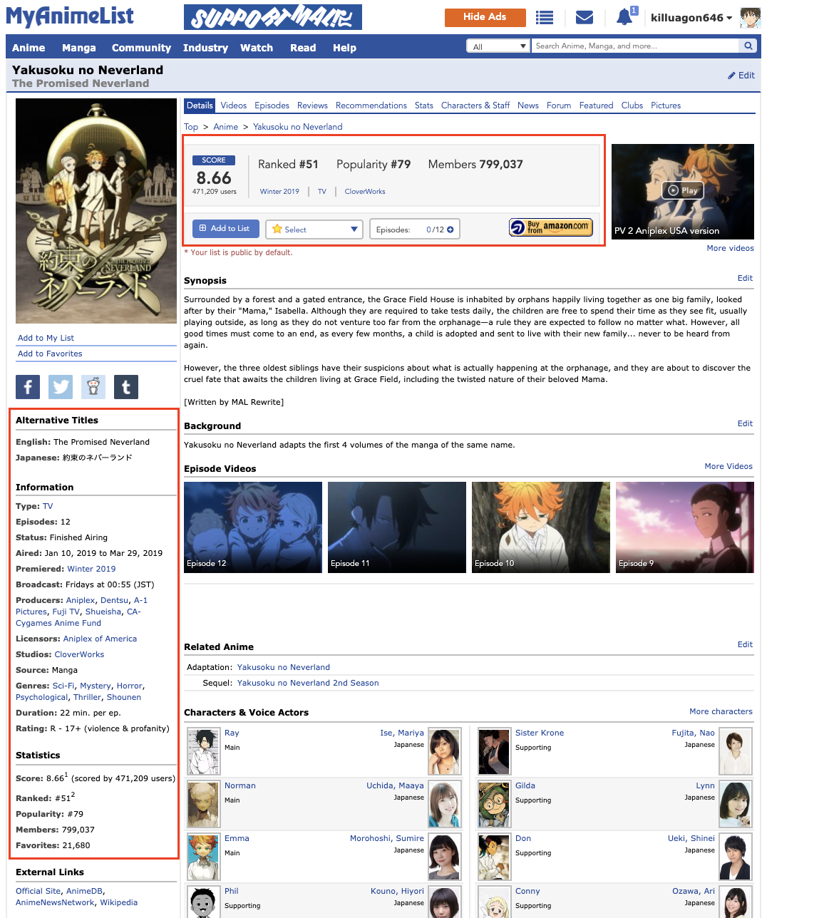
Hybrid Recommender System
Content-based Filtering
Collaborative Filtering
Anime
Features
Anime
Features
=
Users
Users

Slide 7




Recommender System Pipeline
Anime A: 10 points
Anime B: 6 points
Anime C: 12 points
.
.
.
Anime T: 8 points
Anime C: 12 points
Anime A: 10 points
Anime T: 8 points
.
.
.
Anime B: 6 points
Content-based Filtering
10 anime
20 anime
10 anime
10 anime
Collaborative
Filtering
1,000
TOP ANIME
CANDIDATE GENERATION
SCORING
RE-RANKING
RECOMMENDATION

Slide 8





User alesyasabri1 Anime Profile
alesyasabri1
Watches a lot of shounen anime (66%)

Slide 9

Content-based Filtering
Kuroko No Basuke
(another shounen anime)

Slide 10

Collaborative Filtering
Mo Dao Zu Shi
(visually stunning mature action anime)

Slide 11
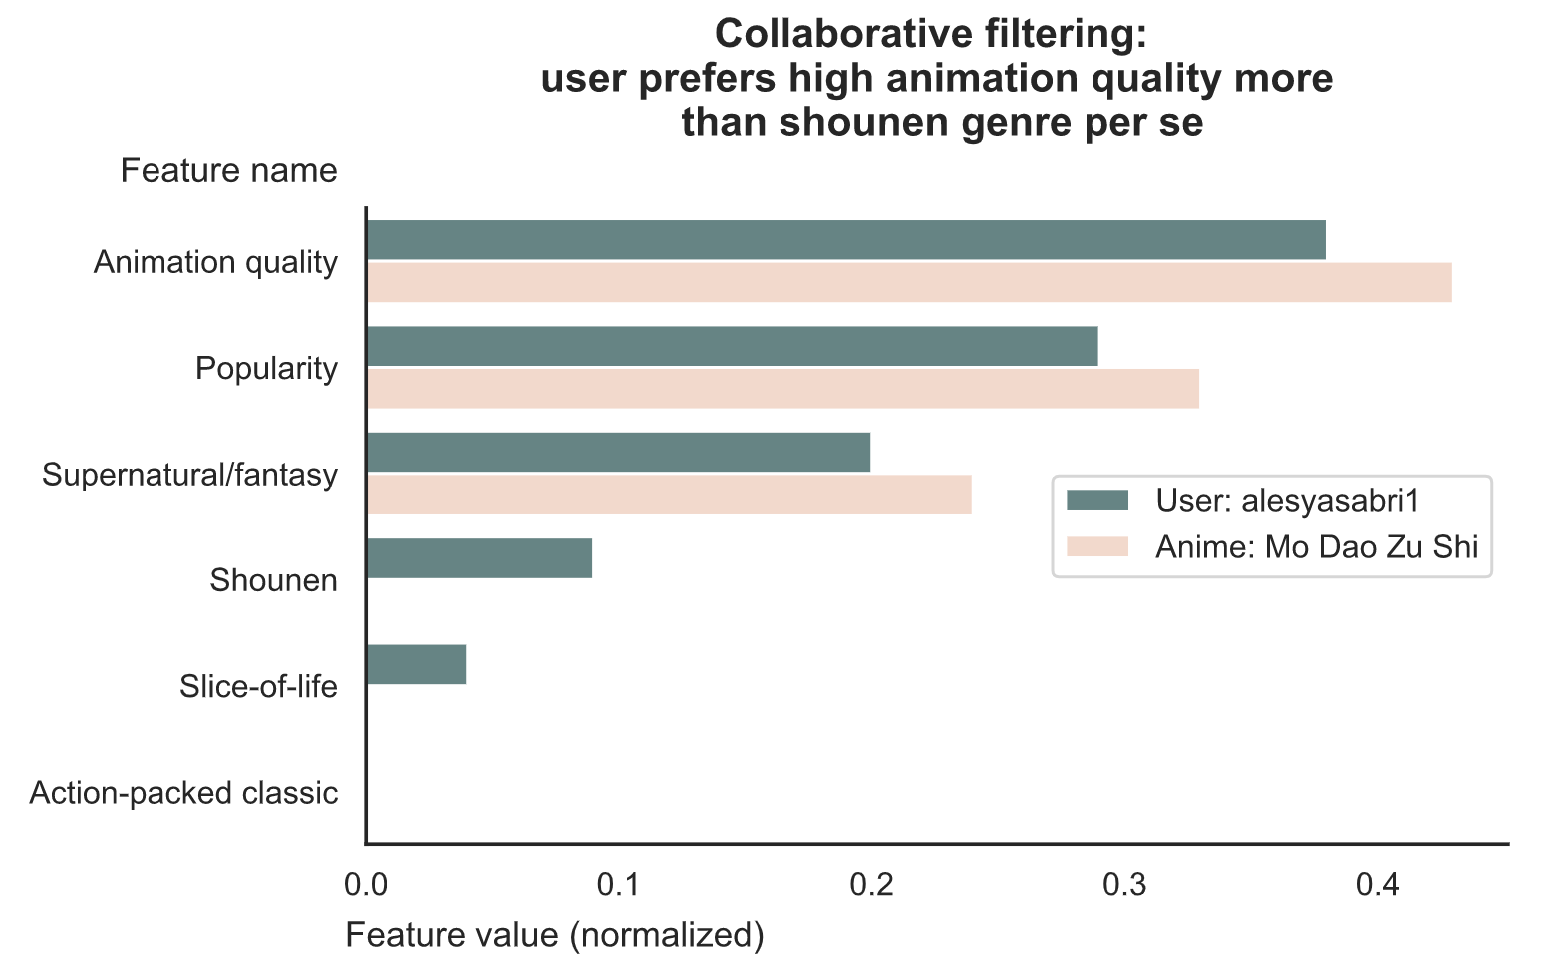
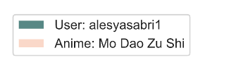

Slide 12
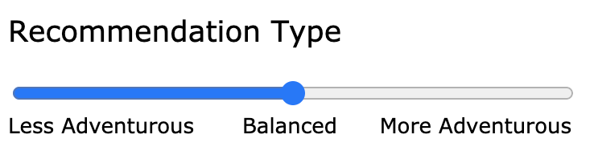


Empower Users
Less Adventurous
(content-based filtering)
Balanced
(mix of both)
More Adventurous
(collaborative filtering)

Slide 13

Thank you
Binh Hoang
LinkedIn: binh748
GitHub: binh748
Images/data were sourced from the internet for educational purposes

